Slide 1
Training BERTimbau
Relevance Classification Model

Slide 2

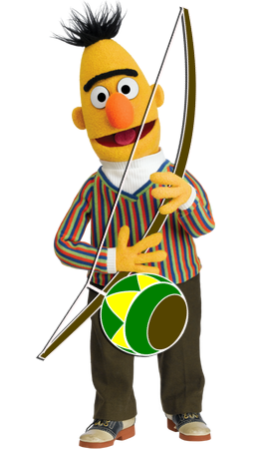
BERTimbau
BERT-BASE-PORTUGUESE-CASED
- pre trained in brazilian portuguese
- sentence textual similarity
- recognizing textual entailment
- name entity recognition

Slide 3
PREPARING THE DATA…

Slide 4
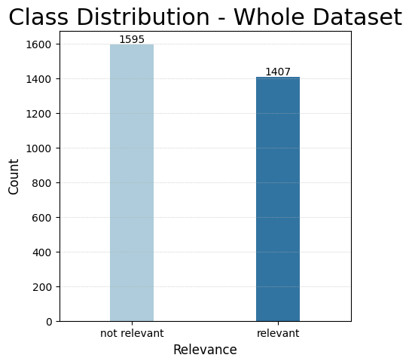

Slide 5
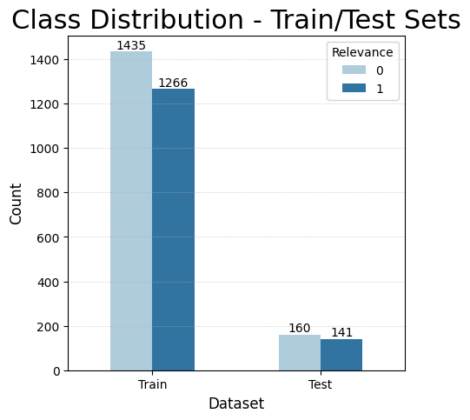

Slide 6
TEST BERTimbau…

Slide 7
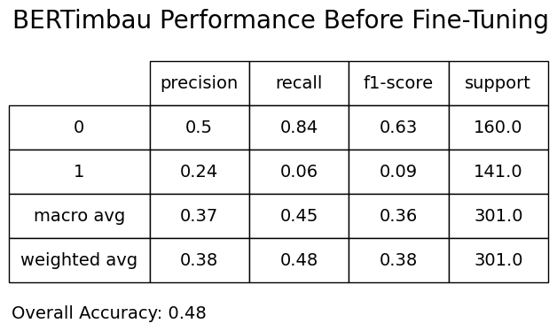

Slide 8
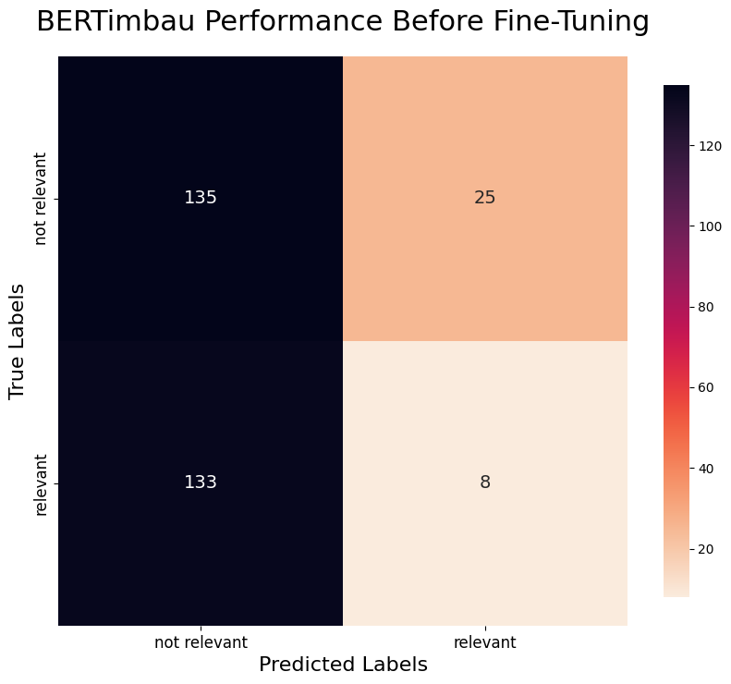

Slide 9
FINE TUNING…

Slide 10
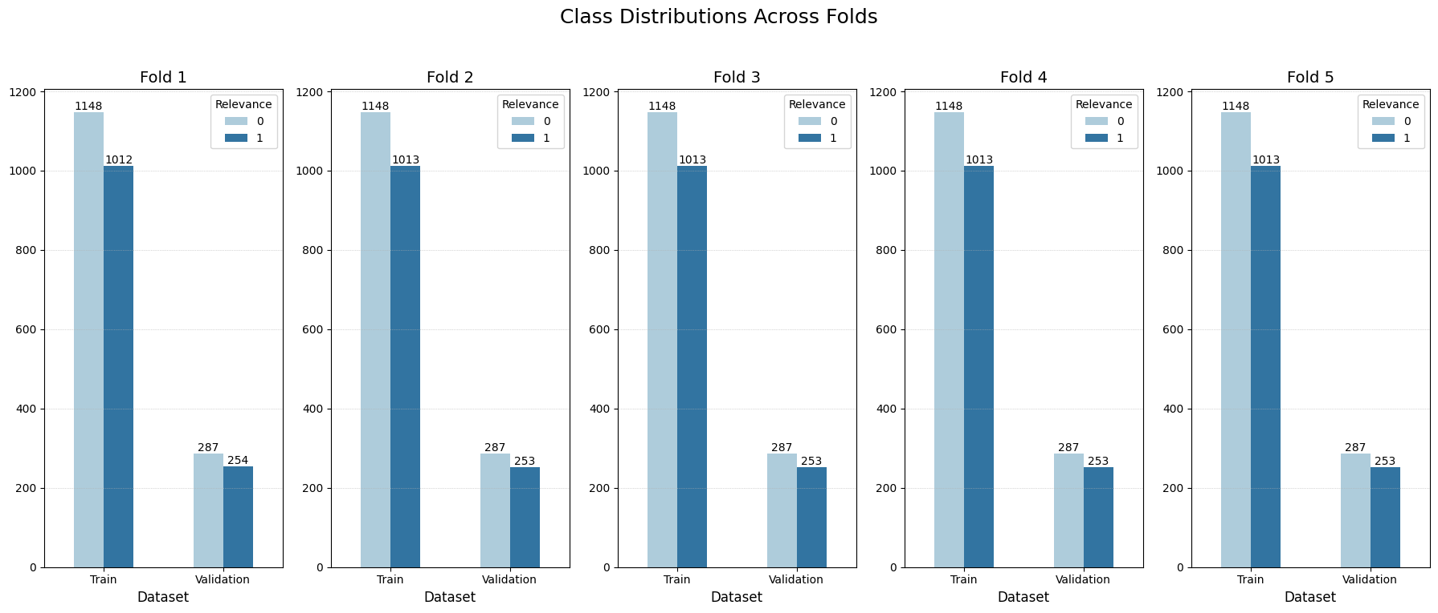

Slide 11
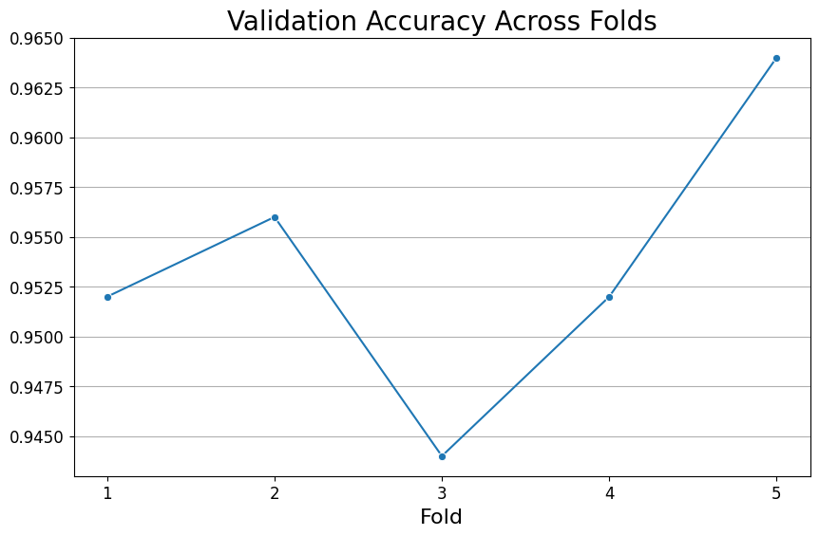

Slide 12
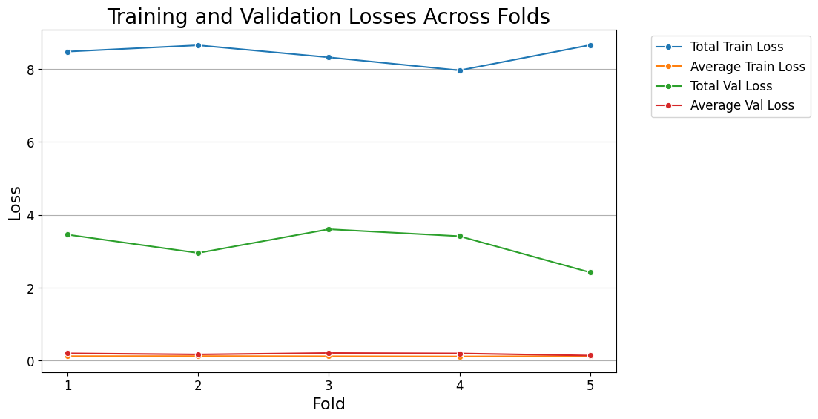

Slide 13
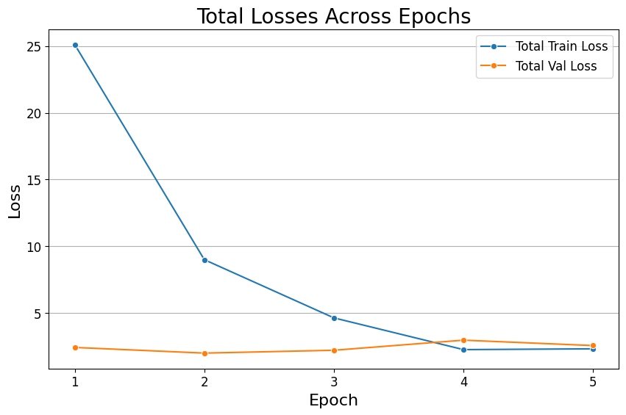

Slide 14
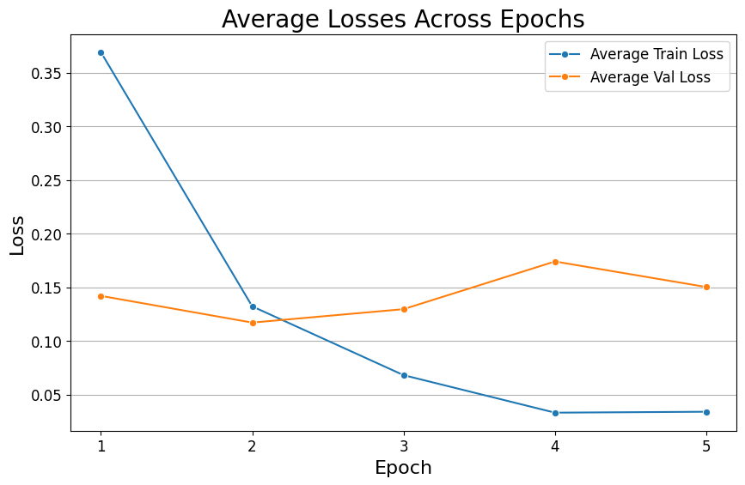

Slide 15
TEST NEW MODEL…

Slide 16
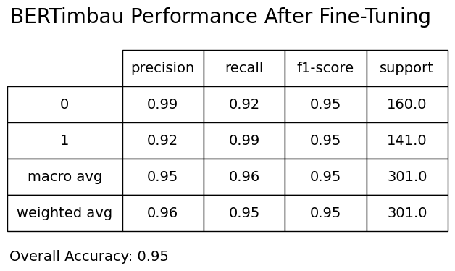

Slide 18
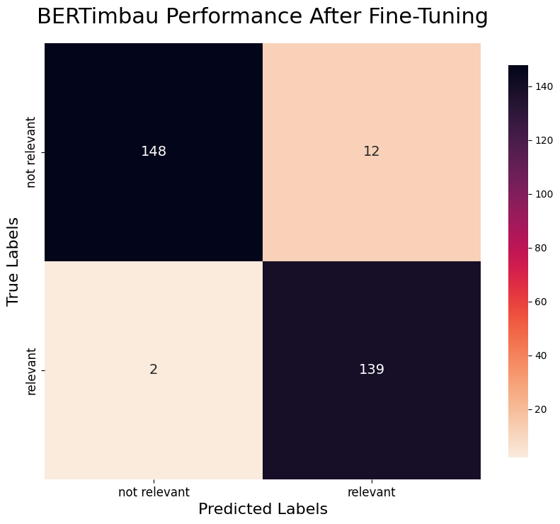

Slide 20
OTHER TRIALS…

Slide 21
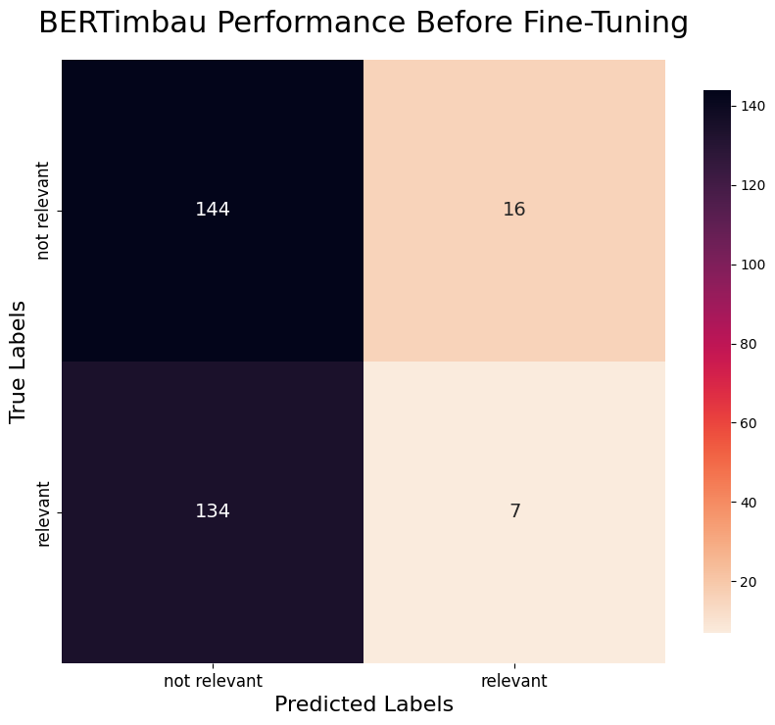
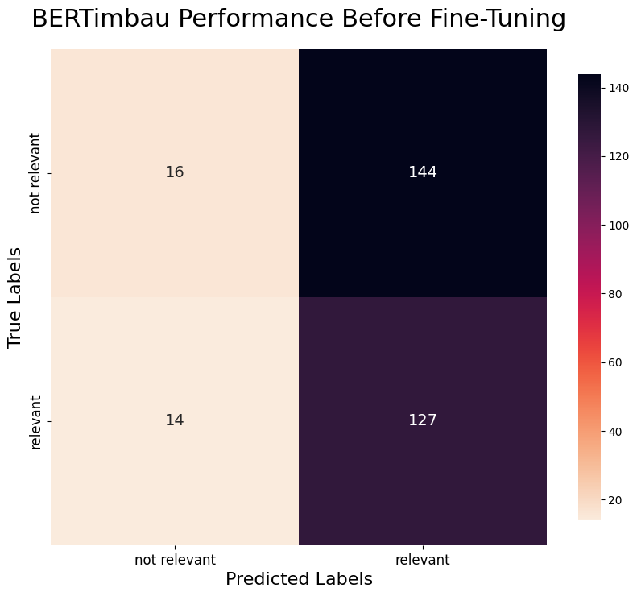
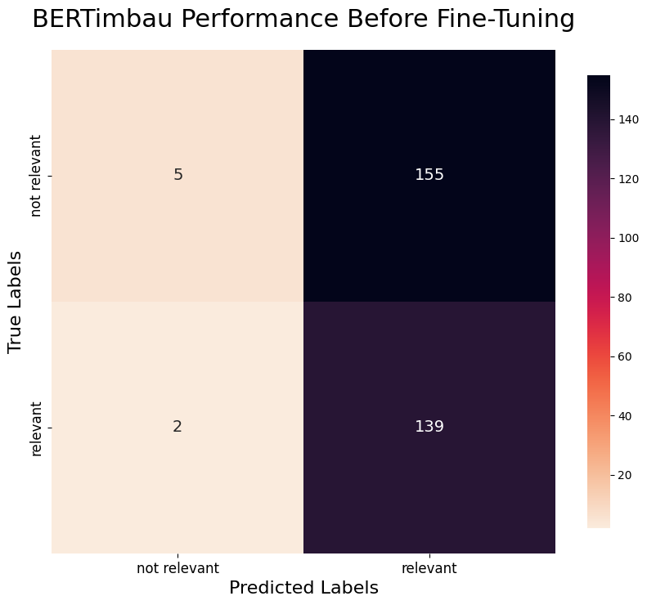
ROUND 1
ROUND 2
ROUND 3
ROUND 4

Slide 22
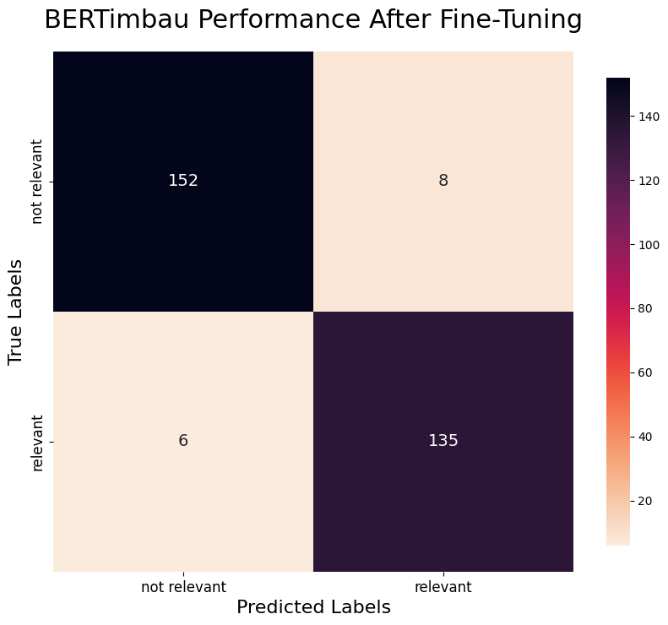
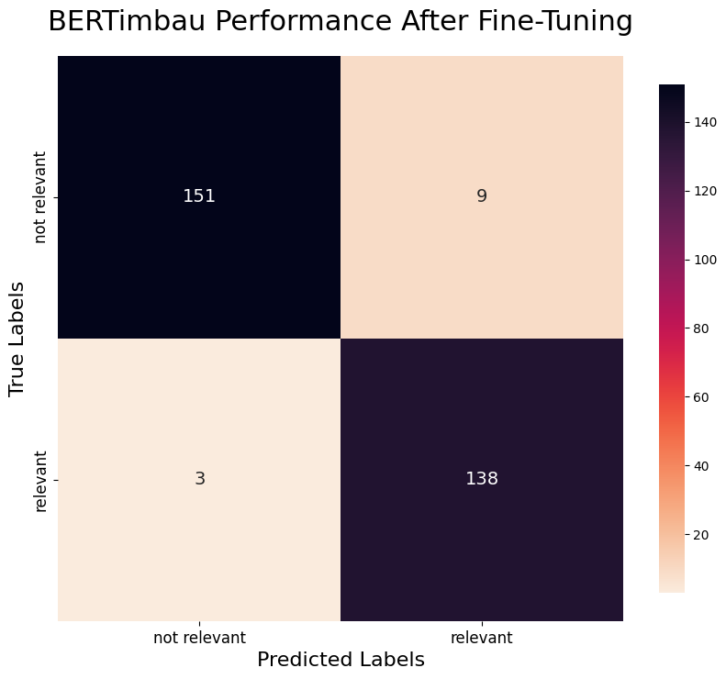
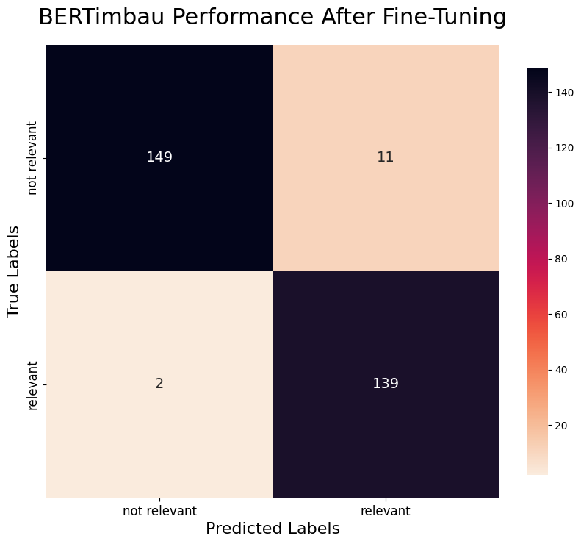
ROUND 1
ROUND 2
ROUND 3
ROUND 4

Slide 23
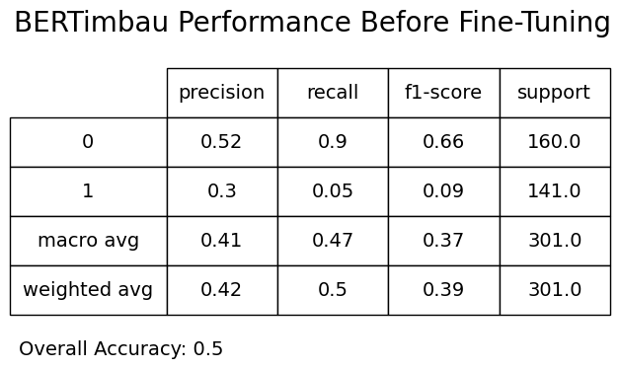
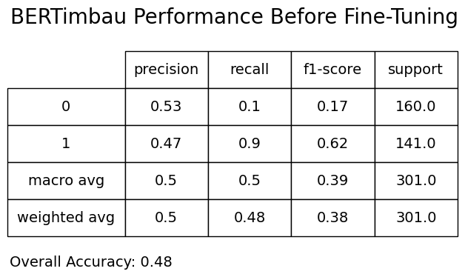
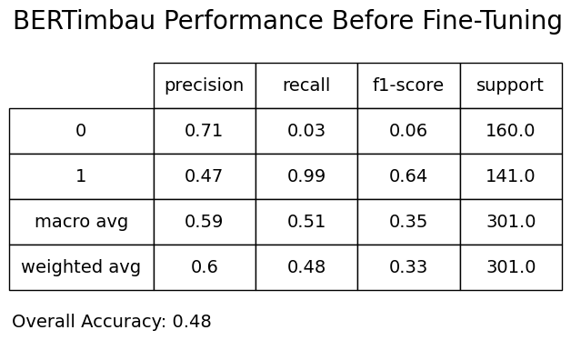
ROUND 1
ROUND 2
ROUND 3
ROUND 4

Slide 24
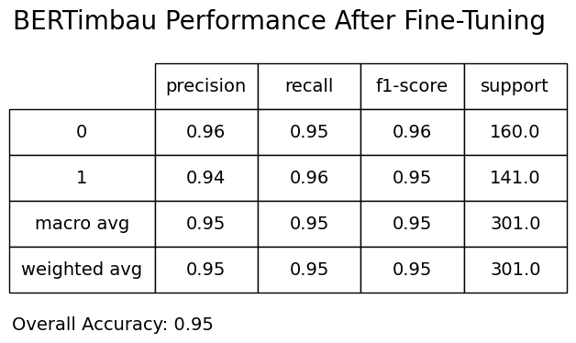
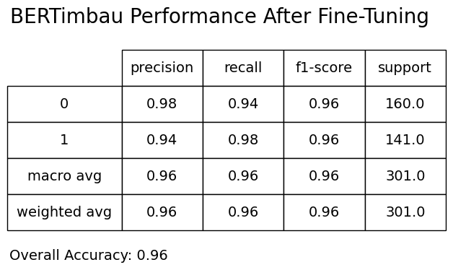

ROUND 1
ROUND 2
ROUND 3
ROUND 4

Slide 25
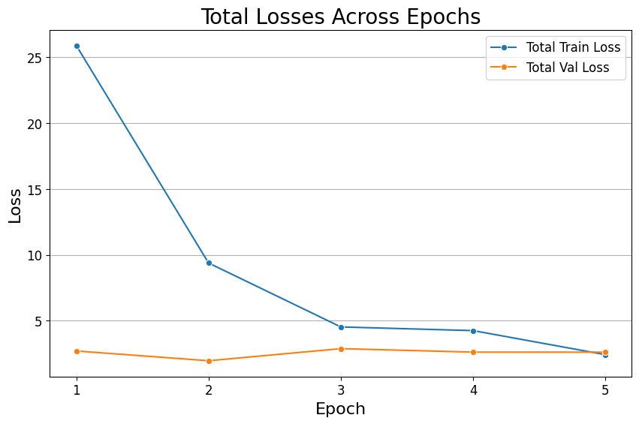
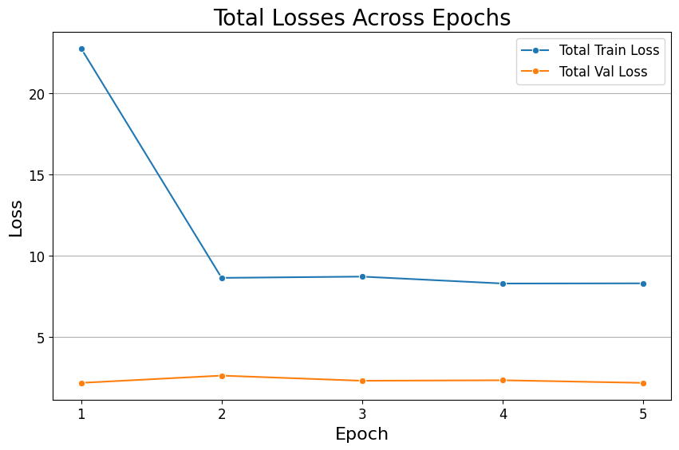
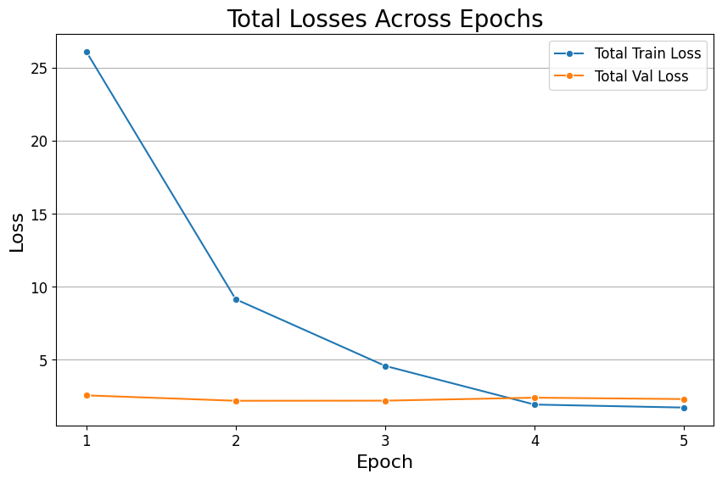
ROUND 1
ROUND 2
ROUND 3
ROUND 4

Slide 26
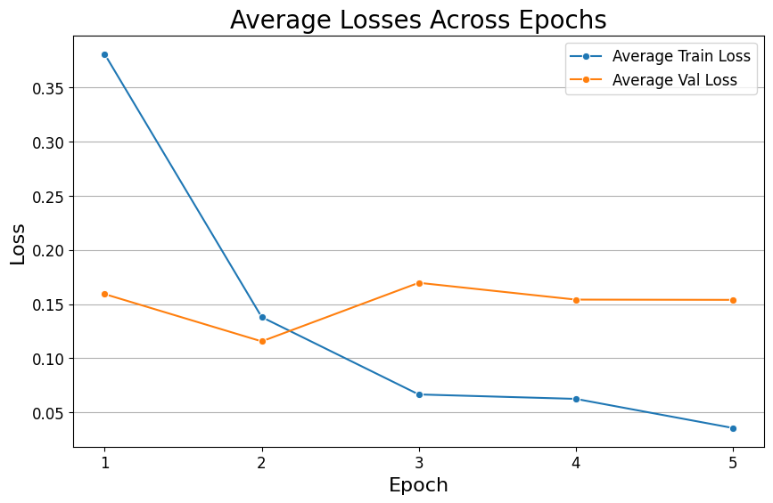
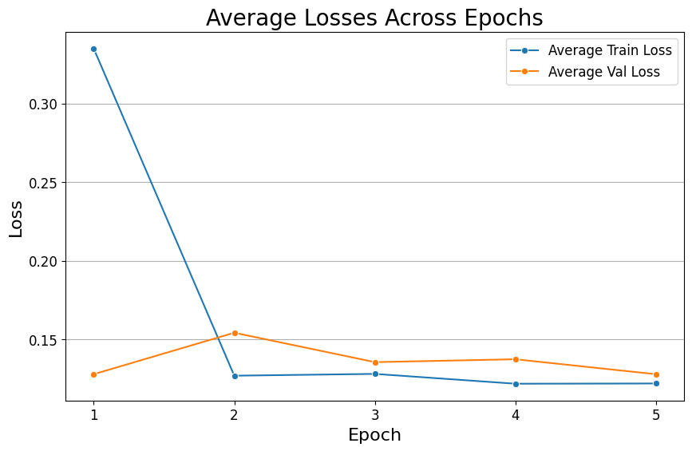
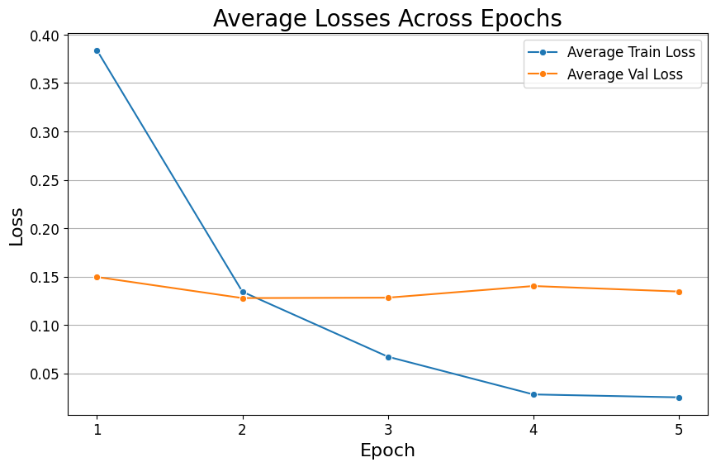
ROUND 1
ROUND 2
ROUND 3
ROUND 4

